Slide 1





esuméble
Create your success!
Notes:
Hello everyone, I'm glad to have you join us today!
Our company is Elements and our product is Resumeble
We want to help you create your success!
Time: 0:0:12

Slide 2

The Problem
Resumes take 4-6 hours each
150 applications
ATS Ranking
6 Second skims
Notes:
The process of creating resumes can be exhausting, stressful, and overwhelming; taking 4-6 hours each
On average, job seekers will send out 150 applications hoping for that 1 job
Your resume is filtered and ranked by an ATS System means employers may not even see your resume
And if they do, an average of 6 seconds is spent looking at it before you are just another one on the stack.
Time: 0:0:30

Slide 3
IS THERE A BETTER WAY?
Notes:
At this point, you have to wonder... Is there a better way?
Time: 0:0:05

Slide 4

Solution
Fast resumes
ATS Friendly
Job Specific
AI improvements
Notes:
We think the solution is obvious:
Create fast resumes
Make them ATS Friendly
Tailor them specifically for each job
Utilize AI improvements to get you through the ATS gatekeepers, and separate your resume from the rest
Time: 0:0:17

Slide 5

What is an ATS?
APPLICANT TRACKING SYTEM
LOOKS FOR:
KEYWORDS
SPELLING ERRORS
FORMATTING
Notes:
So we've been saying ATS at lot, but what is it?
ATS is short for Applicant tracking system
A program that reads your resume for keywords, spelling errors, and even formatting to rank it among thousands that an employer gets.
That's right... if your resume is not "ATS friendly", the employer may not even see it.
Time: 0:0:24

Slide 6



The Start of a Better Way
Notes:
I would like to introduce Tim, our CEO, to tell you why he wanted to find a better way.
Time: 0:0:7+ Tim's story

Slide 7







Target Market
Job Seekers
18 to 65
Recruiters
Notes:
Our target market is two fold:
Job Seekers then Recruiters.
Job seekers includes University students, new grads, anyone jumping jobs or looking to find new ones
Making our Serviceable Available Market: aged 18 to 65
Recruiters can include:
University Career Services, Businesses, Talent agencies, and headhunters
We hope to build a userbase of Job seekers then introduce employee seekers utilize our user pool for potential hiring.
Time: 0:0:32

Slide 8
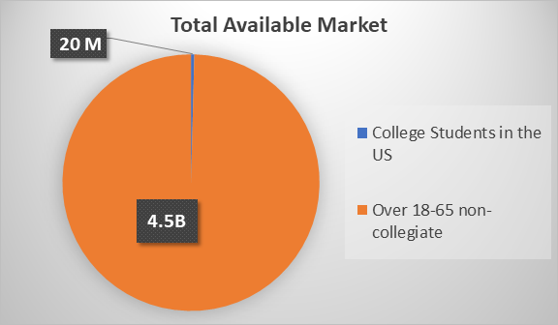
Notes:
There are no shortage of people looking for jobs
Our Total available market of age 18 to 65 consists of 4.7 billion people world wide, all of them potentially looking for new or different jobs.
For the first 2 to 3 years, we will focus our SAM on the 20 Million College students in the US.
Time: 0:0:22

Slide 9







Marketing & Sales
Campus Outreach
SERVICES
Recruiters
Public Presence
Notes:
Our Marketing strategy include working with career services and campus ambassadors who know the university well, and already have incentives to help their students succeed.
Working with recruiters to help them improve their client's resumes and utilize our user pool for recruiting
Leveraging advertising using social media like facebook, instagram, google ads to increase our public presence
Hosting and attending public events and conferences
Time: 0:0:30

Slide 10




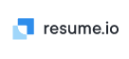




Competitors
RESUME BUILDER
esuméble
NETWORKING
AI
JOB SEARCH
Notes:
Our competitors are categorized by their ability to promote resume building, networking, job searching, and utilizing AI
Notable competitors include:
- network focused LinkedIn
- Job search focused Indeed, and ZipRecruiter
- resume builder focused ResumePuppy, resume.io, myPerfect resume, Resume Now.
and
- AI Resume assist JobScan
Most, if not all focus on only one aspect, whereas we provide both Resume building and improvements through AI
Time: 0:0:29

Slide 11
Our Competitive Advantages
Personalized
Fast
Make individual resumes for each job description
AI-powered tool helps reduce time when compared to professional career services
Customizable
Recommendations
Can add or remove suggested changes on an individual basis
Get recommendations for particular skills based on the job requirements
Notes:
Our system provides
Resumes Personalized for each job
AI powered means you create your resumes fast!
Customizable, which means you can add or remove suggested changes as you like
And skill Recommendations based on the job requirement
Time: 0:0:20

Slide 12

%63 said they believe it's effective to create a resume based on the job descriptions
%63 said they already fill out more than 30 applications per year
%89 would sign up for an account
Notes:
Over %63 of surveyed users believe in creating resumes based on the job description.
Surveys in our target market have reported %89 would sign up for an account.
9% of those would pay for a subscription
With COVID vaccinations becoming widely available, more people will be back looking for jobs for the next few years as businesses continue to recover.
Time: 0:0:29

Slide 13


A Freemium Model
SaaS
Low overhead
Low Barrier of Entry
Fast Growth
Recruiters
Large Userbase
Subscriptions
Advertising
Notes:
Our Freemium Business model Scales well with Software as a service model and gives us the benefit of lower overhead costs
Low barrier to entry for users encourages Fast growth, and a large userbase is attractive to recruiters
More recruiters attract more users in a cycle of growth
Our revenue will stem from Subscriptions and targeted advertising
Time: 0:0:23

Slide 14



















2022
SAM: 38,665
The
Expansion Plan
2023
SAM: 130,769
2024
Notes:
To give our company focus, we are targeting schools during our development phase
Year 2022 will focus with the five college consortium. The contained population will allow us to analyze our growth and implement improvements.
Year 2023 will include 6 new schools, Umass Boston, Lowell, Dartmouth, Boston College, Harvard, and Northeastern increasing our serviceable available market by about 131,000 students
Our year 2024 plan will depend on our 2023 assessment. If we feel our product needs more maturing, then we will focus our efforts reaching the 160,000 students from MIT, PennState, Tufts, Bridgewater, Boston College, and Bunker Hill Community College. Otherwise, we will begin statewide expansion efforts for 2024.
- our Goal would then be at least 1 state every 2 months
- Massachusetts, Connecticut, Rhode Island, Maine, New Hampshire, and Vermont.
for a SAM of over 10 million
Time: 0:1:22

Slide 15
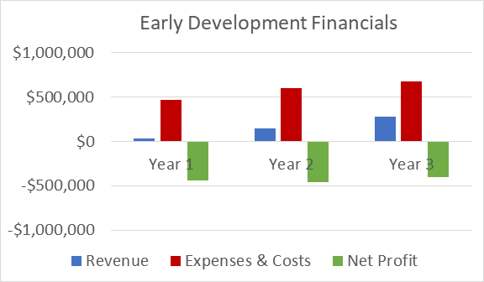
Projections
Revenue Streams
Premium Subscriptions
Advertising
Notes:
This is our current Revenue, Expenses, and Net Profit projections for the first two to three years of product development.
These years are focused on developing and adjusting the product to align with market demands.
Time: 0:0:14

Slide 16
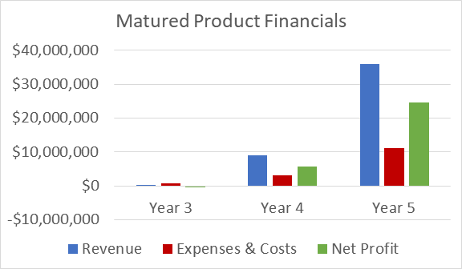
Projections
Notes:
Once we believe our product has reached a desired maturity, we will begin expansion at a state by state level. We expect to begin this phase in year 3 or 4.
Our revenue is speculated to out scale our expenses at an exponential rate. We also expect to reach profitability the same year we begin state-wide expansion.
Time: 0:0:22

Slide 17
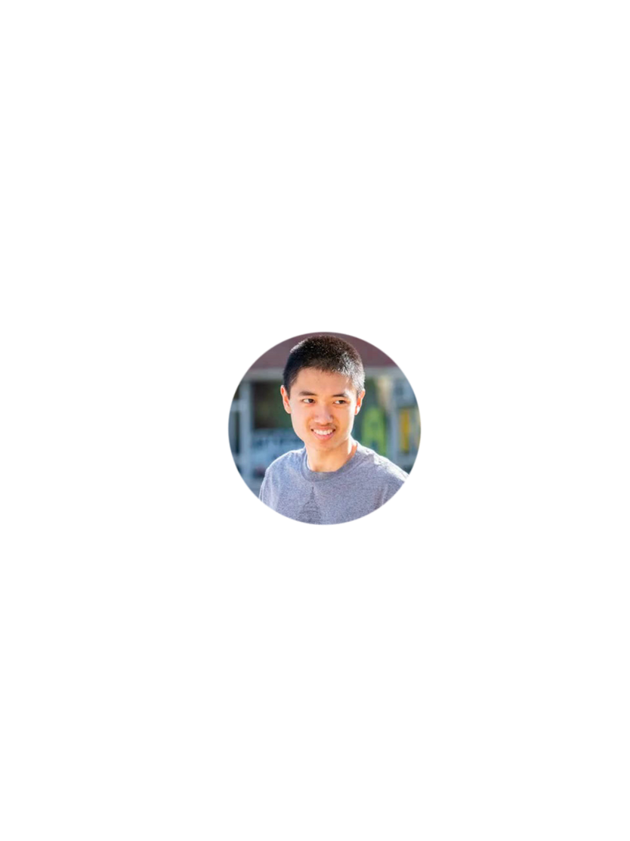
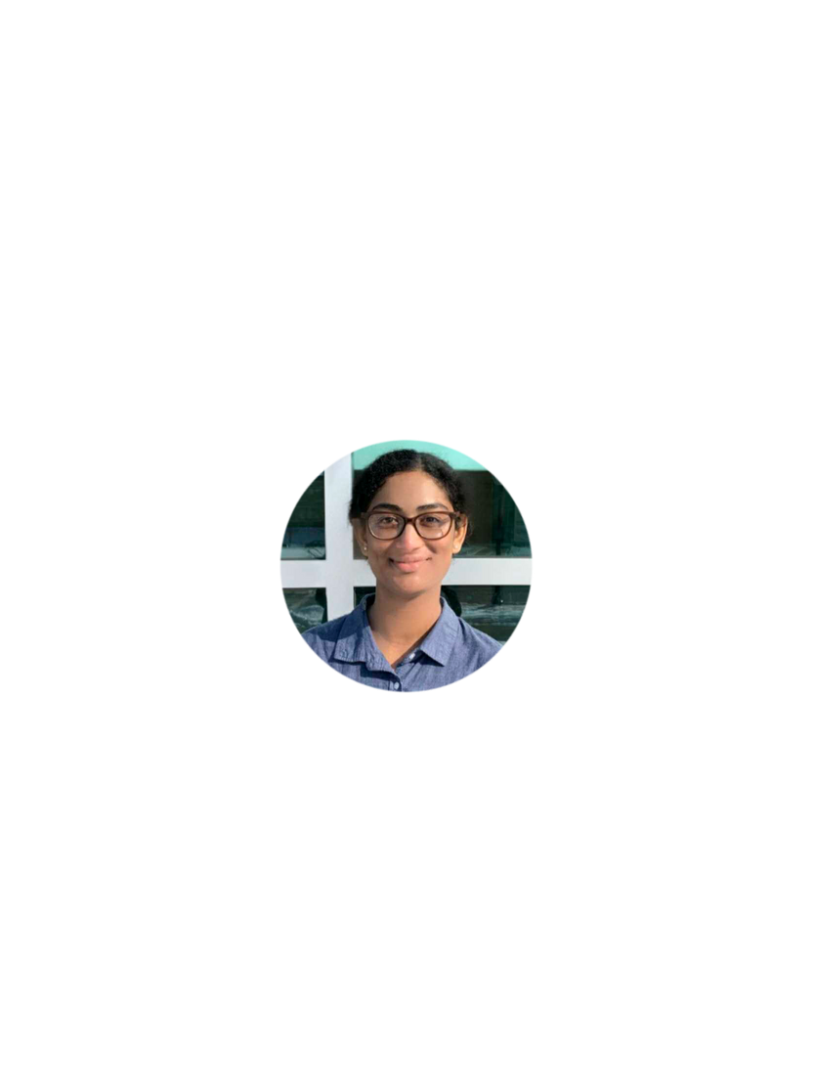
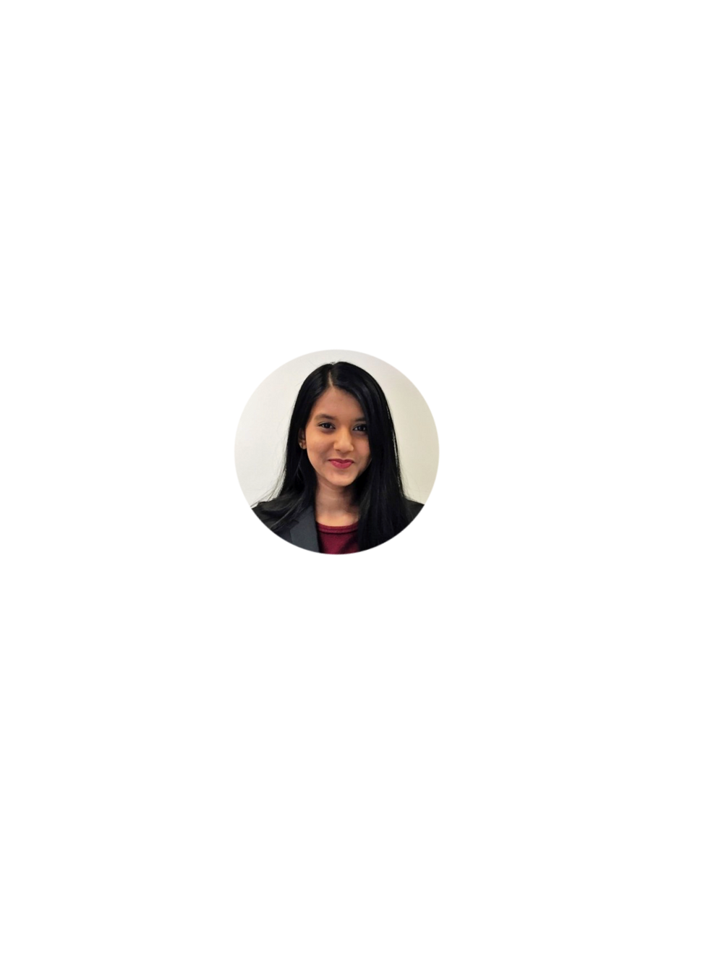

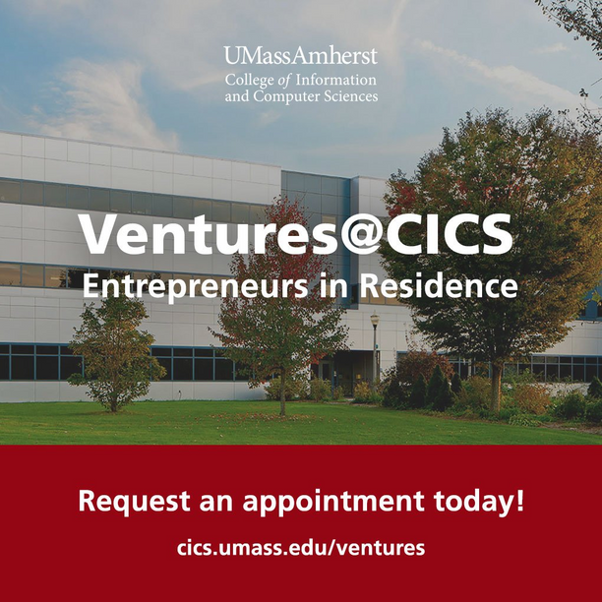
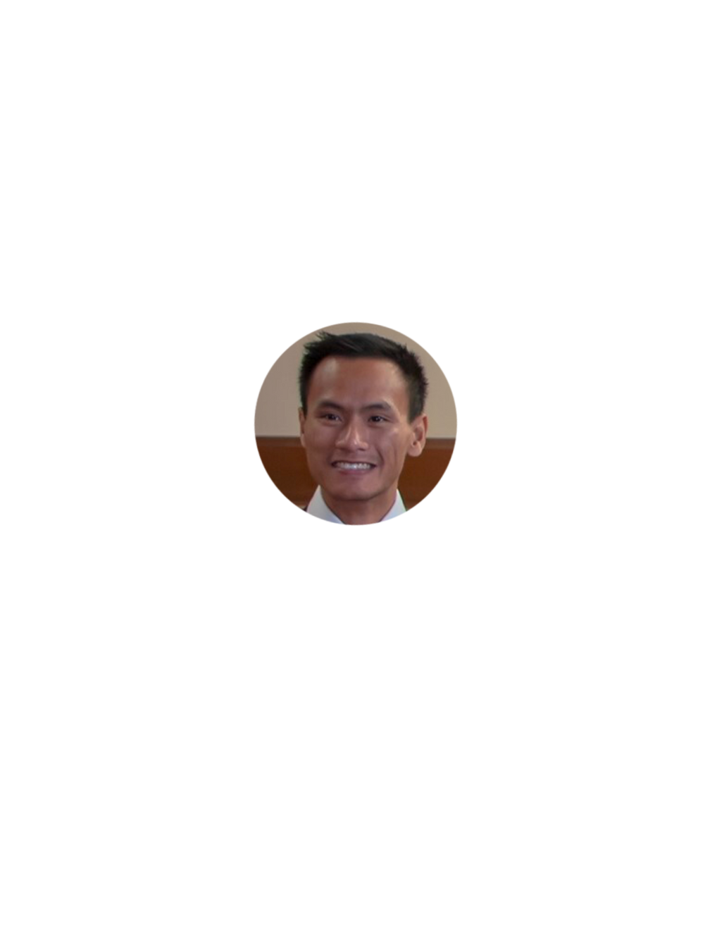



The Company
Advisors and Mentors
Timothy Nguyen
CEO
Jhinnie Shome
CMO
Anushree Jana
COO
You!
Nam Phan
CFO
Herlin Rijo
CTO
Notes:
I would like to introduce our company:
Tim is the CEO, and the creative vision of our team
Jhinnie: Chief Marketing Officer, in charge of market strategy
Nam: Chief Financial Officer,
in charge of everything finances
Anushree our Chief Operating Officer, overseeing our day to day operations
Herlin: Chief Technology officer, making all internal and external technology decisions
We are leveraging advising resources from Berthiaume(bear-taume) center for entrepreneurship, and our own Entrepreneurs in Residence
And you! Even if you don't decide to fund us, we would love the opportunity to network with you!
Time: 0:0:47

Slide 18
Contact Us!
resumeblecompany@gmail.com
https://hrijo3.wixsite.com/resumeble
Notes:
A big thank you from all of us!
Please feel free to contact us via email. We would love to get in touch with everyone!
Here is our fearless leader to show you our MVP!
Time: 0:0:09
Total Time:454s=7.6 minutes

Slide 22
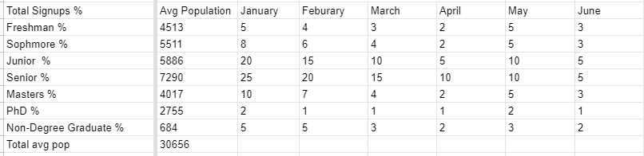
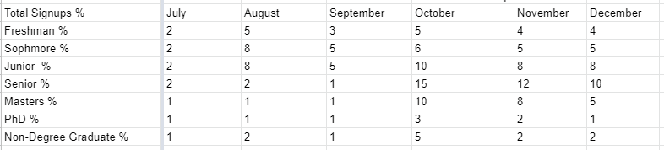

Slide 23
%65
SALARY
%7
OFFICE SPACE
%2.8
NECESSITIES
%2.2
MARKETING
%0.6
WEB HOSTING

Slide 24
SALARIES
COFOUNDERS- $72,000
ENGINEERS- $80,000
NON-ENGINEER STAFF- $50,000

